Slide 1
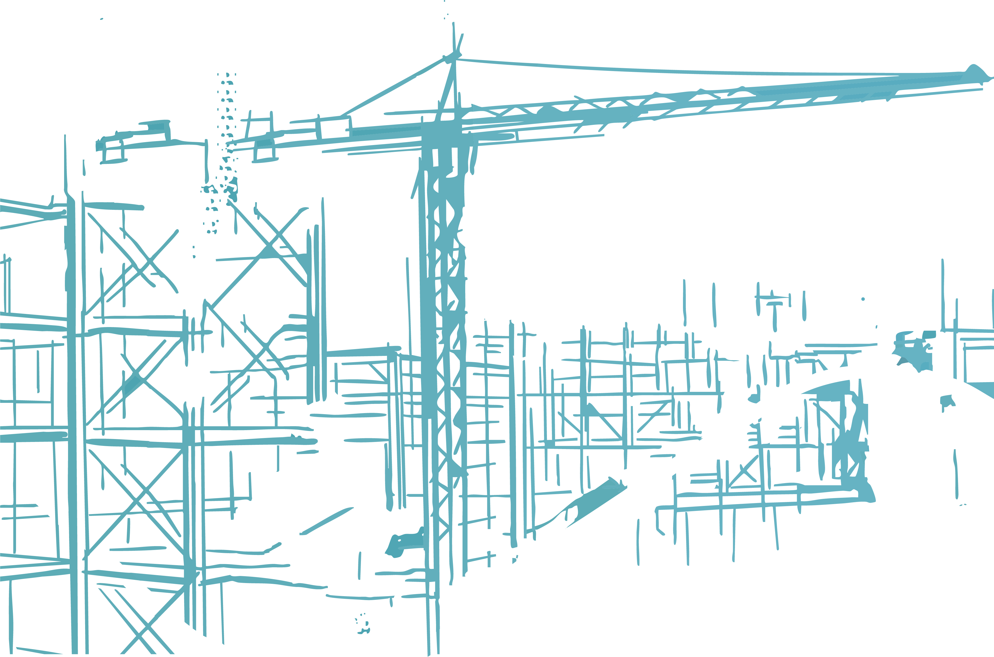


CONSTRUCTION & BUILT ENVIRONMENT CHAMPIONS:
Introducing your role and the wider construction industry in Cornwall and the Isles of Scilly

Slide 2
Delivery plan for Construction Champions
READ ME!
A 40–50-minute resource to help you introduce your role and current labour market information around the wider Cornish construction industry. Use it as a stand-alone class/assembly talk or as an opener to a curriculum challenge or group activity.
SEQUENCE & TIMINGS | ACTIVITY DESCRIPTION
Getting started 10m Slide 4 or Slide 5 | Introduce yourself and get straight in to Option 1 or 2 Option 1: Use slide 4 if pupils know you work in Construction & the Built Environment; ask young people to write a word/do a doodle and discuss. You might like to note any negative perceptions they have shared to come back to at the end of your session. Option 2: Use Slide 5 if you have kept your sector unknown; ask pupils to discuss and feedback; reveal the sector, are they surprised at some of the quotes? Why? Why not?
What people love about their job.. 2m Slide 6 | Point out the huge demand for people in Construction & the Built Environment in Cornwall and The Isles of Scilly and play the short film embedded on slide 6 Design and Build Cornwall's Future: What I love about construction is... / https://youtu.be/lZbx9H0y78I
My Job in Construction & The Built Environment 8-10m Slide 7 and 8 (example on Slide 7) | Personalise the slide: Try to avoid lots of text; stick to pictures and key words that will prompt what you want to share and give visual learners a hook. Make sure any ‘jargon’ words are explained; such as ‘salary’, sub-contractor’, ‘supply-chain’, ‘part-time’, ‘contracting’ etc. Things to talk about might include: Explanation of your job title if not obvious A typical day/the tasks you do The pathway into your role The skills you use (or look for in other people if you are an employer) The best thing about your job/The most challenging thing about your job How it balances with your life and your hobbies/ Why you choose to work and live in Cornwall How does your job help in shaping Cornwall’s future?/ If relevant, how is your job contributing to sustainability? Where you see yourself in 5 years' time? Advice for anyone who wants to get into a job like yours

Slide 3
Delivery plan for Construction Champions
TIMINGS AND RESOURCE | ACTIVITY DESCRIPTION
Questions 5-8m | Questions from pupils
Quiz and Labour Market Information 10’ Slides 9-19 | Highlight the Labour market information built into the answers.
Reflection 5’ Slide 20 | An important part of pupils’ careers learning is reflecting on their encounters with employers/professionals. You could lead the reflection yourself or ask the Teacher/Tutor to lead it. In a classroom situation, pupils might like some time to discuss this between themselves in pairs/small groups first before sharing with the whole class. In an assembly situation it can sometimes be challenging to get secondary pupils to speak out, so this could be left to a follow up session for school staff.
Extra resources (Optional) | To fit your audience/ and any perceptions or misperceptions they raise you might like to share one or more of the short films (sub one-minute) below or on Slide 21 Sustainability and Construction - https://youtu.be/UhIXr9bw1wM Women in Construction - https://youtu.be/H_eCS_WPuW4 Pathways and Progression in Construction – https://youtu.be/bTkOTbXK2HU We have also developed a range of ‘postcards’ that have information and signposting around roles in demand links for pupils, staff and parents. They are a growing resource which you can access for free to share either digitally or physically. We have created them for our Careers Hub Construction Champions and local industry, so no need to get our permission to print/use. Just help yourself here - Construction in Cornwall

Slide 4


What comes to mind when you think of construction in Cornwall?

Slide 5

What industry are these young Cornish people and students talking about?
“You can go anywhere in the world”
“You get to meet a lot of friends as you’re always working in a team”
“You get to
be an adult sooner”
“It’s about freedom – it’s so much fun”
“The best part is being involved in sustainable projects to shape a greener future”
“No two days are the same”
“I love applying mathematics to what Cornwall will look like in the future”
“It’s an easy way into a decent paying job – you can earn money quicker”
“It’s better than sitting down in a quiet room working to exams”

Slide 6
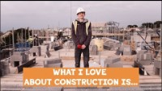



The Construction &
Built Environment Sector
DID YOU KNOW…
that the number of jobs in the Construction & Built Environment industry has grown 2.5 times faster than the wider Cornish jobs market?
WATCH:
What do people working in Construction in Cornwall love about their job?

Slide 7



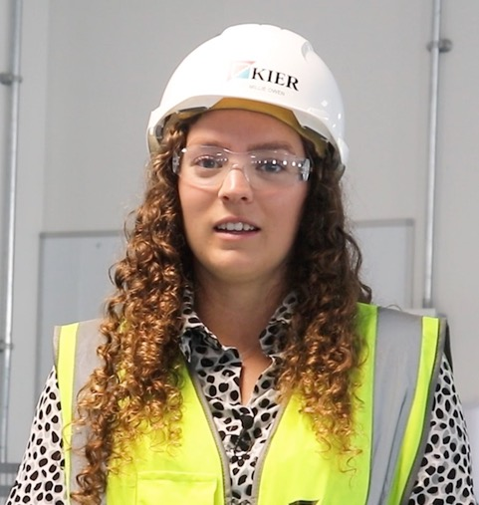
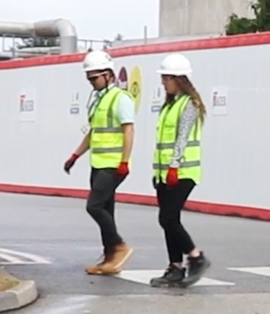
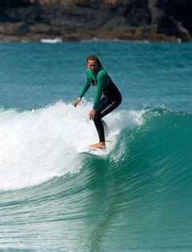
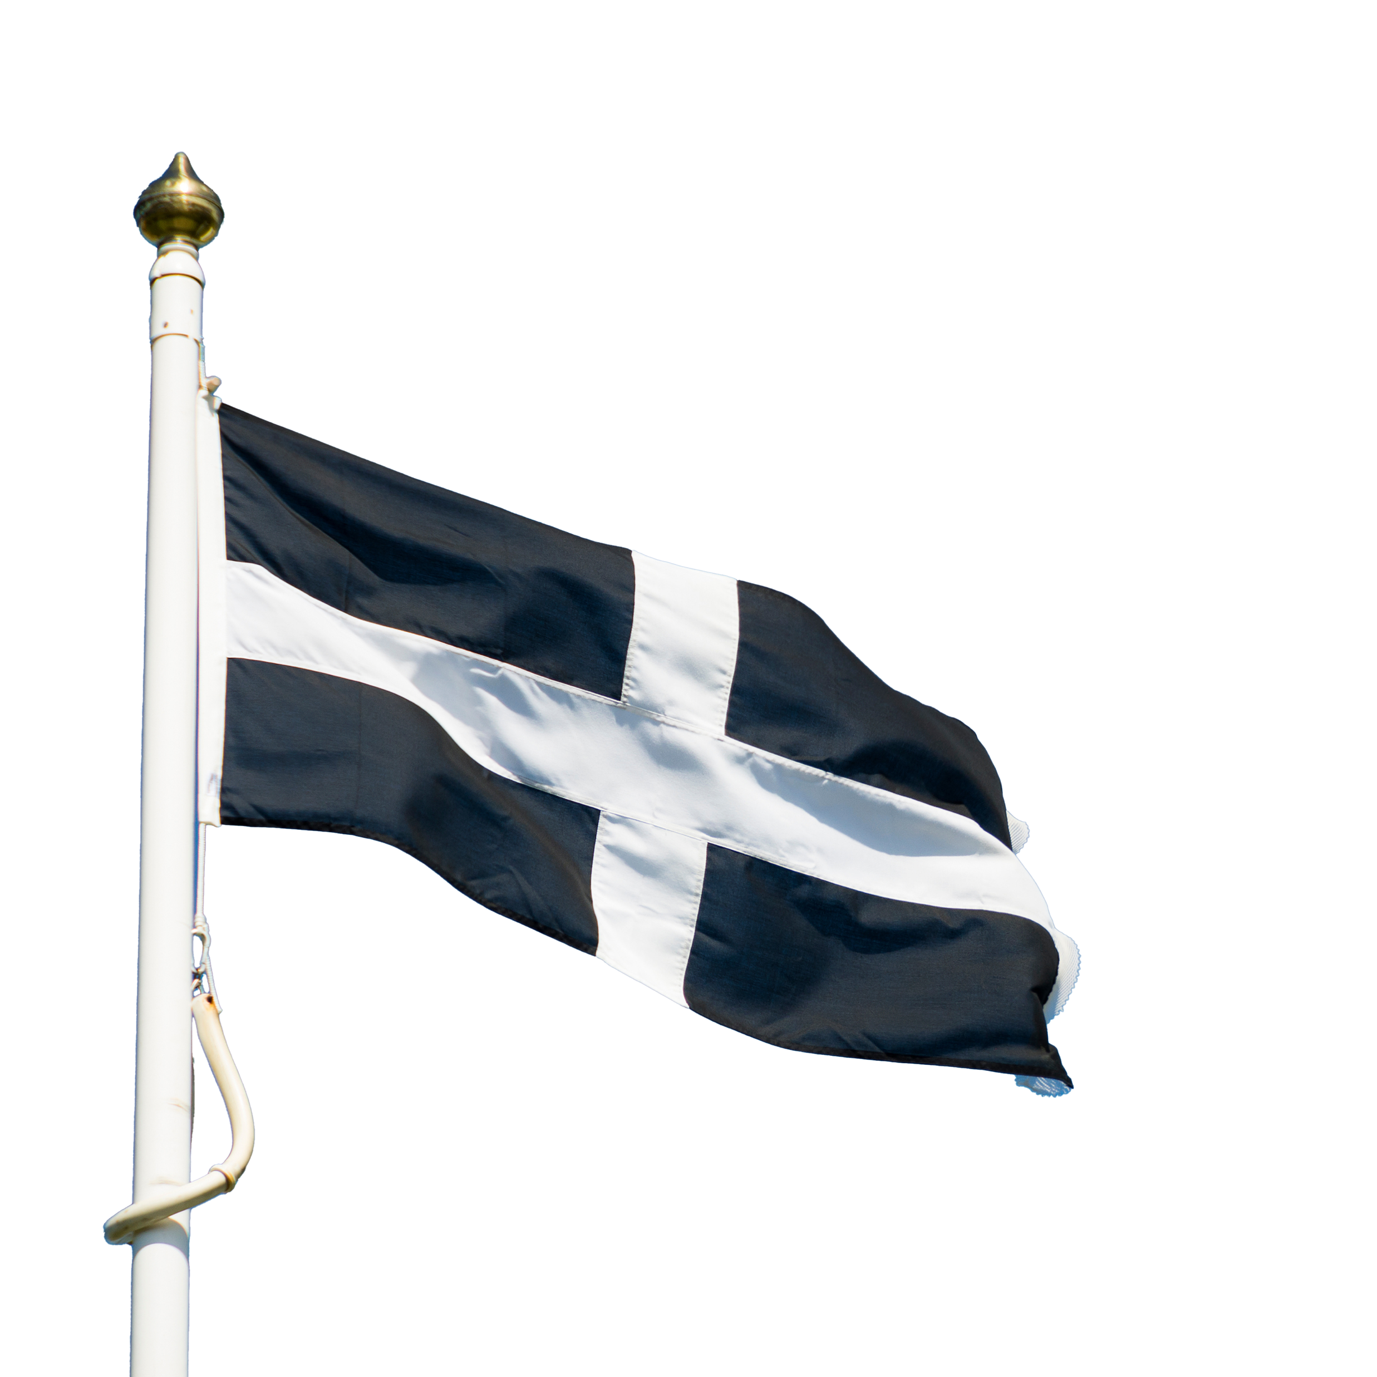


My Job in Construction
& The Built Environment
My route in…
University
Apprenticeship
A day in the life of Millie…
My day…
Working on Contracts & Payments
On Site
BEST BITS:
The people I get to work with who help and inspire me!
New challenges every day
TOP SKILLS…
Communication
Time Management
Maths Calculations!
In the Office
At Home
WORK-LIFE BALANCE
Assistant Quantity Surveyor
CHALLENGES?
Juggling more than one project, each one is so different
Quantity Surveyors are in
BIG demand in Cornwall!
In 5 years… PROJECT MANAGER!

Slide 8




My Job in Construction
& The Built Environment
My route in…
University
Apprenticeship
A day in the life of XXX…
My day…
Fact 1
Fact 2
BEST BITS:
Bullet 1
Bullet 2
TOP SKILLS…
Skill 1
Skill 2
Skill 3
Fact 3
Fact 4
WORK-LIFE BALANCE
Job role here
CHALLENGES?
Bullet 1
Bullet 2
[Fact about job role in Cornwall here]
In 5 years… [PROGRESSION ROLE]

Slide 9
Quick Quiz
GET INTO GROUPS
What do you know about the Construction & Built Environment Industry in Cornwall and the Isles of Scilly?

Slide 10
QUIZ: Construction in Cornwall and the Isles of Scilly
Q1. What is the average salary for people working
in Construction & The Built Environment
in Cornwall and the Isles of Scilly?
A. £26, 550
B. £31,660
C. £36, 770

Slide 11
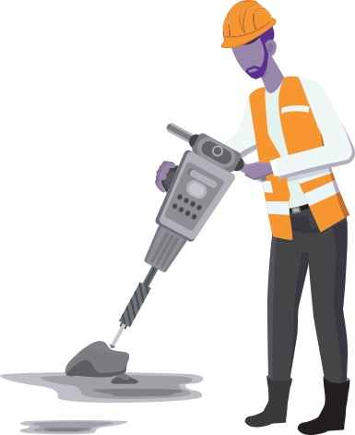
QUIZ: Construction in Cornwall and the Isles of Scilly
ANSWER
Q1. What is the average salary for people working
in Construction & The Built Environment
in Cornwall and the Isles of Scilly?
C. £36, 770
Construction wages are 36% higher than the average Cornish salary:
Skilled tradespeople …can earn up to £55,000
Surveyors and Engineers … can earn up to £80,000
Project Managers and Managing Directors ….can earn up to £100,000!

Slide 12
QUIZ: Construction in Cornwall and the Isles of Scilly
Q2. True or False:
The construction industry has the largest
number of businesses in Cornwall.
TRUE
FALSE

Slide 13

QUIZ: Construction in Cornwall and the Isles of Scilly
ANSWER
Q2. True or False:
The construction industry has the largest
number of businesses in Cornwall.
TRUE
16% of all our Cornish businesses are construction companies and around
16,000 people are working in construction roles right now.
There are plenty of jobs at all levels – you can get started through traineeships, apprenticeships, T-Levels and Vocational qualifications,
A-Levels or University
Over 400 people in Cornwall started a construction apprenticeship last year!

Slide 14
QUIZ: Construction in Cornwall and the Isles of Scilly
Q3. True or False:
All construction roles involve an element of getting
‘hands on’, being outdoors and getting mucky?
TRUE
FALSE

Slide 15

QUIZ: Construction in Cornwall and the Isles of Scilly
ANSWER
Q3. True or False:
All construction roles involve an element of getting
‘hands on’, being outdoors and getting mucky?
That’s a myth! If you want to be practical and hands on you can…
But professional roles that involve designing, planning, programming, inspecting and management are in big demand!
FALSE

Slide 16
QUIZ: Construction in Cornwall and the Isles of Scilly
Q4. How is the construction and built environment sector going to help us reach our Carbon Net Zero goals?
A. By ‘retro-fitting’ homes to make them more energy efficient with insulation, heat pumps and solar panels.
B. By using digital technologies, robotics and 3D printing to create buildings in ‘modules’ in factories with environmentally friendly materials and less waste.
C. By contributing to the building of structures for renewable energy sources such as Geothermal and Offshore Wind Energy.

Slide 17

QUIZ: Construction in Cornwall and the Isles of Scilly
ANSWER
Q4. How is the construction and built environment sector going to help us reach our Carbon Net Zero goals?
All of these! If your values are rooted in environmental sustainability, and positively shaping Cornwall’s future landscape, then a career in construction could see you making a major impact. And digital skills will be in big demand!

Slide 18
QUIZ: Construction in Cornwall and the Isles of Scilly
Q5. True or False:
The construction industry is dominated by men.
TRUE
FALSE

Slide 19
QUIZ: Construction in Cornwall and the Isles of Scilly
ANSWER
Q5. True or False:
The construction industry is dominated by men.
TRUE
This is true, BUT the story here is changing rapidly.
The industry is becoming more inclusive with a much better gender balance. So, it’s definitely not just a ‘job for the boys’ anymore!

Slide 20

Would you consider doing my job, or another job in construction & the built environment? Why/Why not?
Has anything you learned today surprised you/ made you rethink your ideas about construction & the built environment?
What comes to mind now when you think of construction in Cornwall?
For more info on the variety of construction jobs and pathways into them, check out Go Construct: www.goconstruct.org

Slide 21

